Slide 1

Project Title - Retail Insights from Superstore Data
Ankit Pathak
IIT Kharagpur
Applied Geology (Final year)

Slide 2

PROBLEM STATEMENT
Analyse the Sample superstore dataset that describes the sales in each state segregated by category, segments and regions. Derive relationship between sales v/s region, profit v/s region, sales v/s category and profit v/s category and make report by visualizing on bar chart and pie chart so that it would enable organizations to make data driven decisions.

Slide 3
The project aims at analysing the Sample superstore dataset by statistical analysis of : Segment v/s sales & Segment v/s profit Sales v/s region & Profit v/s region Sales v/s category & Profit v/s category Sales v/s state & Profit v/s state Segment
Project Description

Slide 4

WHO ARE THE END USERS?
Business Analysts
Data Analysts
Marketing team (to analyse sales data)
Organization stakeholders (data driven decisions)
Product manufacturers (by analysing production v/s profit)
Company employees
Future Data analysts
Product users

Slide 5

Technology Used
Python
Pandas, NumPy, Matplotlib
Power BI
Microsoft Excel
Power Query
SQL

Slide 6
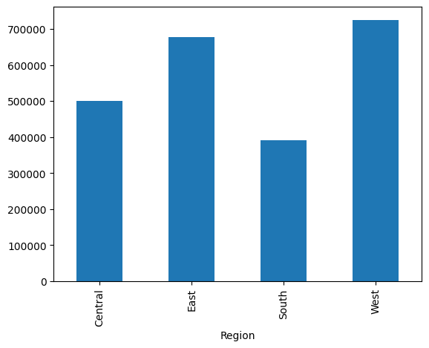
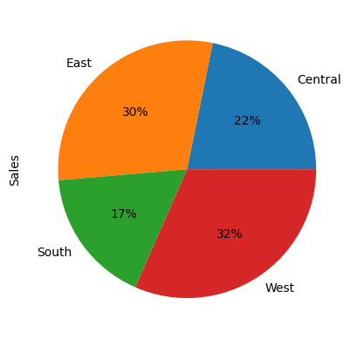
RESULTS
Link to Project Source Code

Slide 7
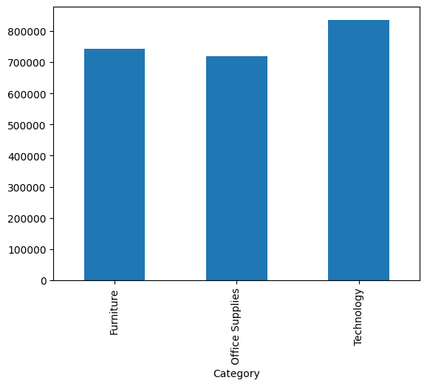
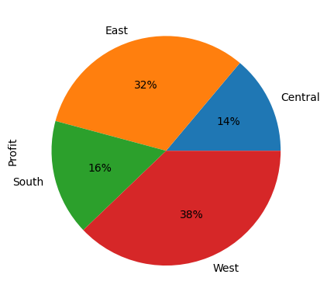
RESULTS
Link to Project Source Code

Slide 8
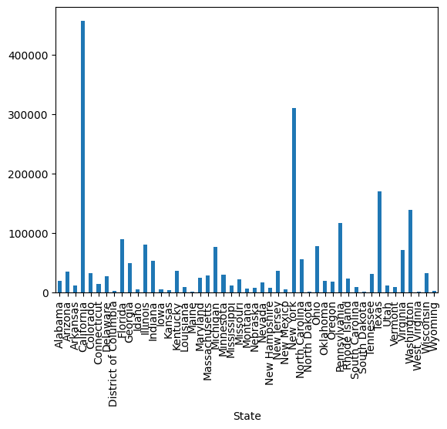
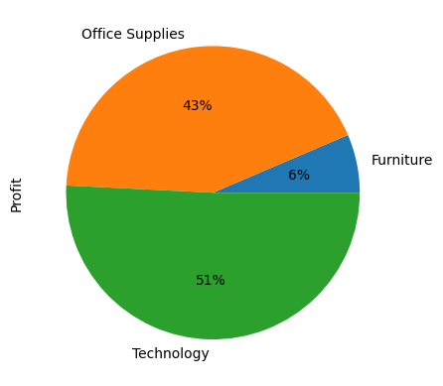
RESULTS
[Add screen shots of your code ]
Link to Project Source Code

Slide 9
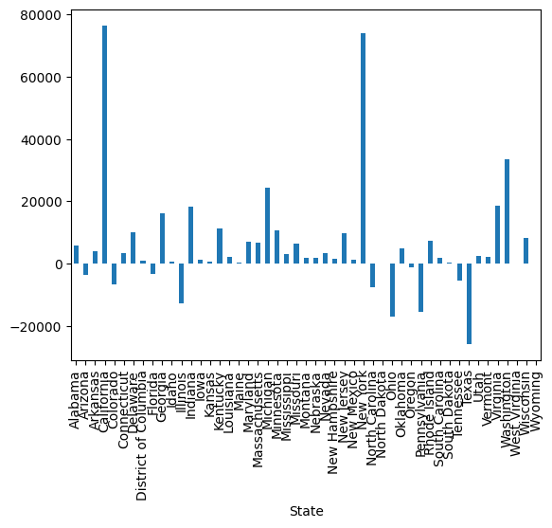
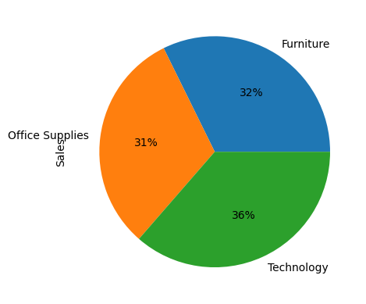
RESULTS
[Add screen shots of your code ]
Link to Project Source Code

Slide 10
Thank you
In this project, we collected and loaded sample superstore data to Pandas data frame and visualized the data by analysing sales and profit data segregated by region. This project will enable organizations to make data driven decisions.
.
.

